Slide 1
React JS

Slide 2





Timeline of front-end JavaScript frameworks
jQuery* (2006)
AngularJS (2010)
React (2013)
Vue (2014)
Angular (2014)
* jQuery is more often considered a library than a framework

Slide 3
Common tasks in front-end development
App state User actions
Templates Routing
Data fetching
Data definition, organization, and storage
Event handlers respond to user actions
Design and render HTML templates
Resolve URLs
Interact with server(s) through APIs and AJAX

Slide 4
What is react
Javascript library
Developed at Facebook
Creates single page applications
Web and mobile applications UI
Present version 19.x

Slide 5
Why react
Component based architecture
Uses virtual DOM for fast rendering
Easy to learn

Slide 6
Key concepts
Components
JSX (JavaScript XML): const element = <h1>Hello, React!</h1>;
State and Props:
Virtual DOM:
Component Lifecycle: mounting, updating, and unmounting.
Handling Events: <button onClick={() => alert('Button Clicked!')}>Click Me</button>

Slide 7
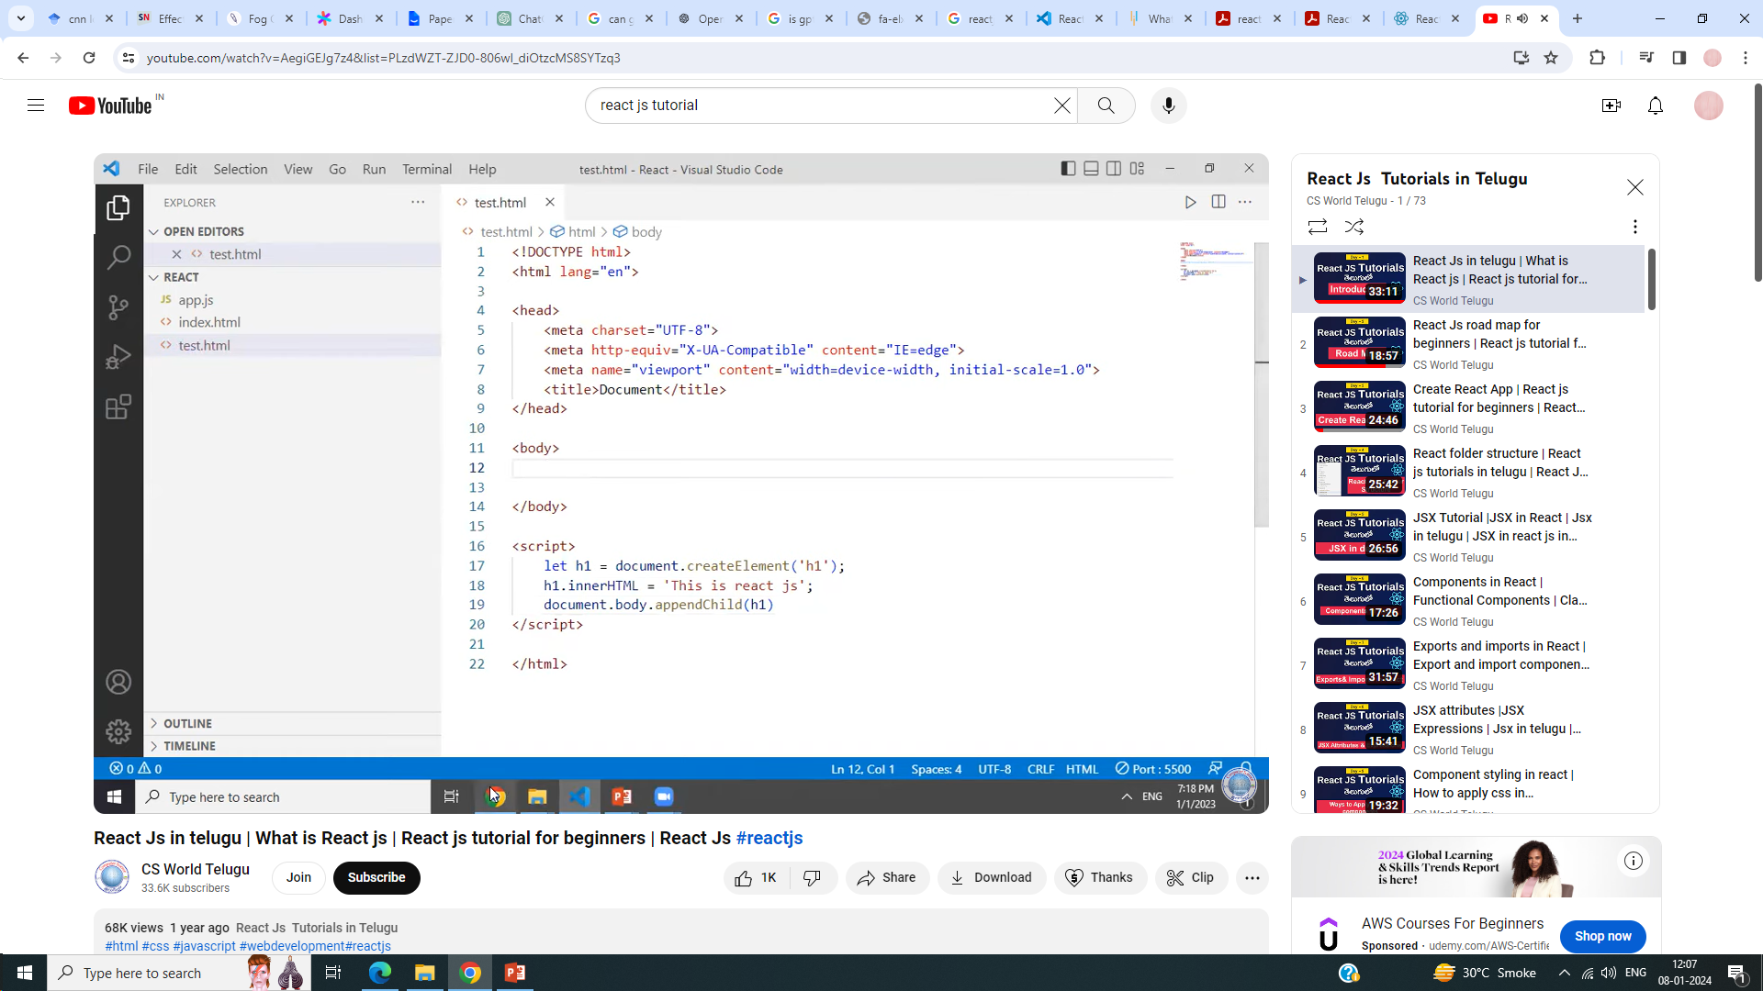
This is a simple js DOM code to create element

Slide 8
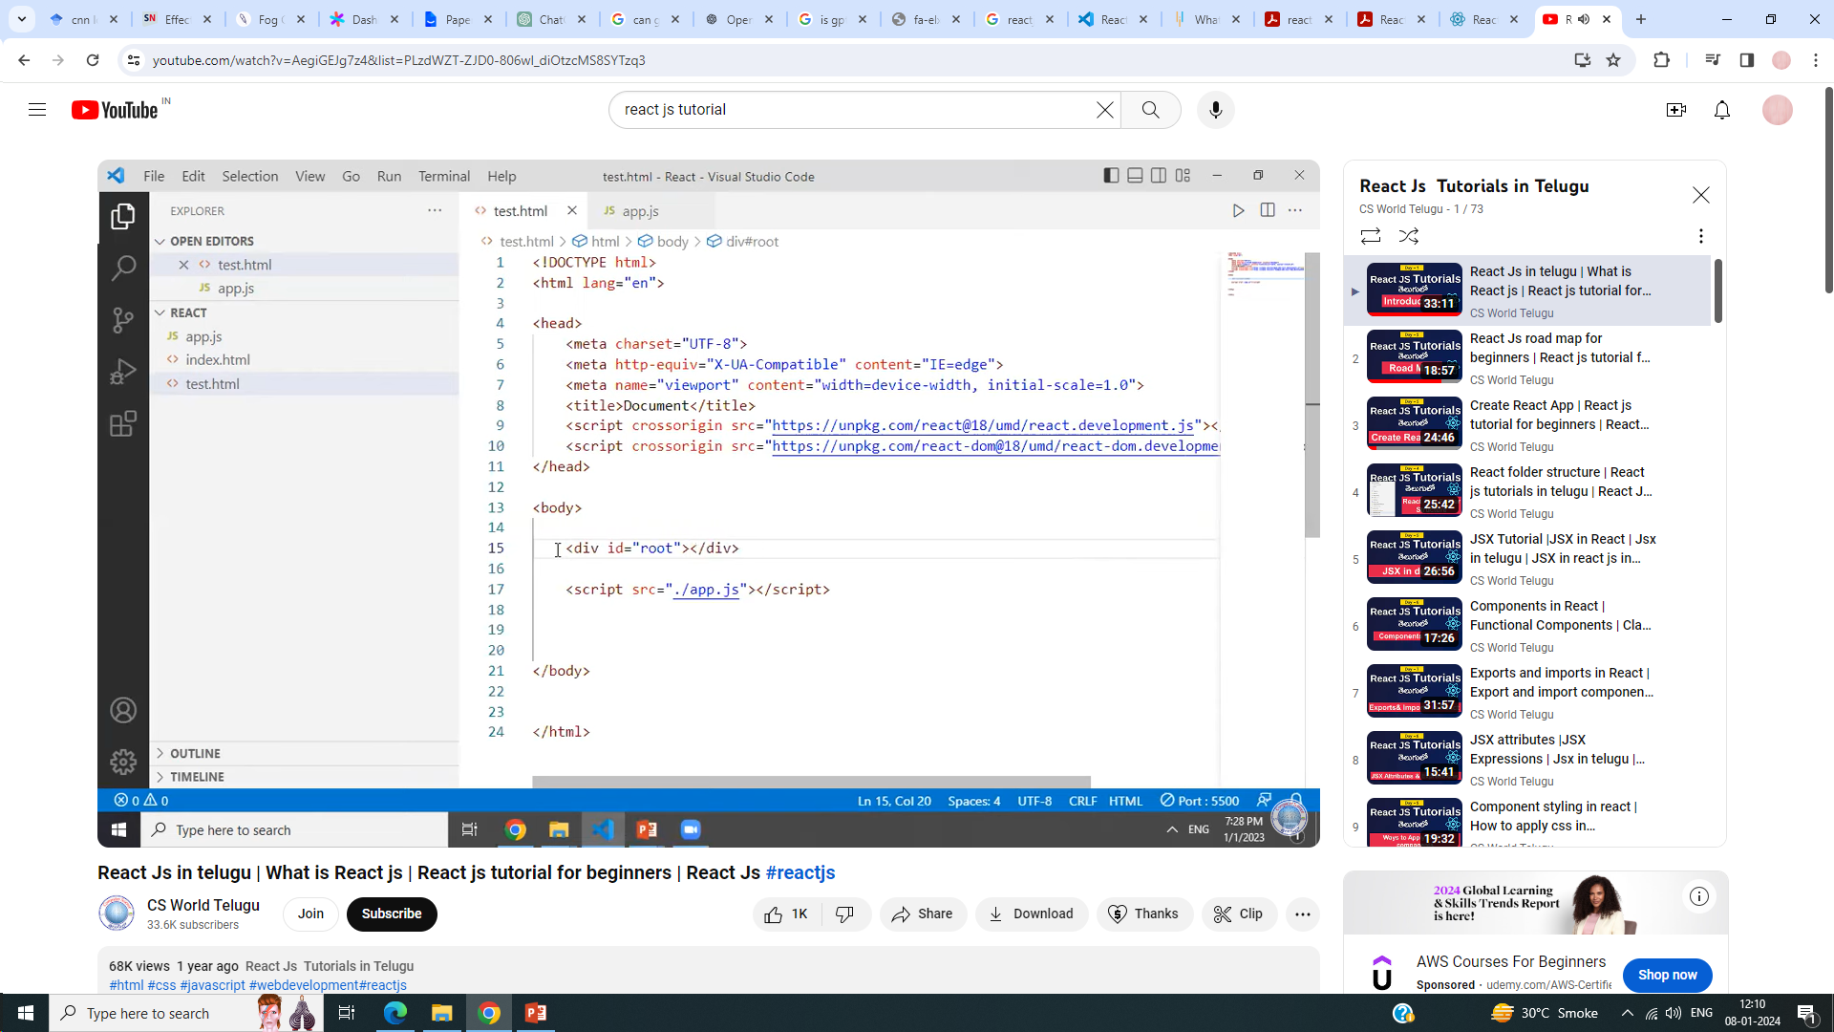
How to do in react

Slide 9
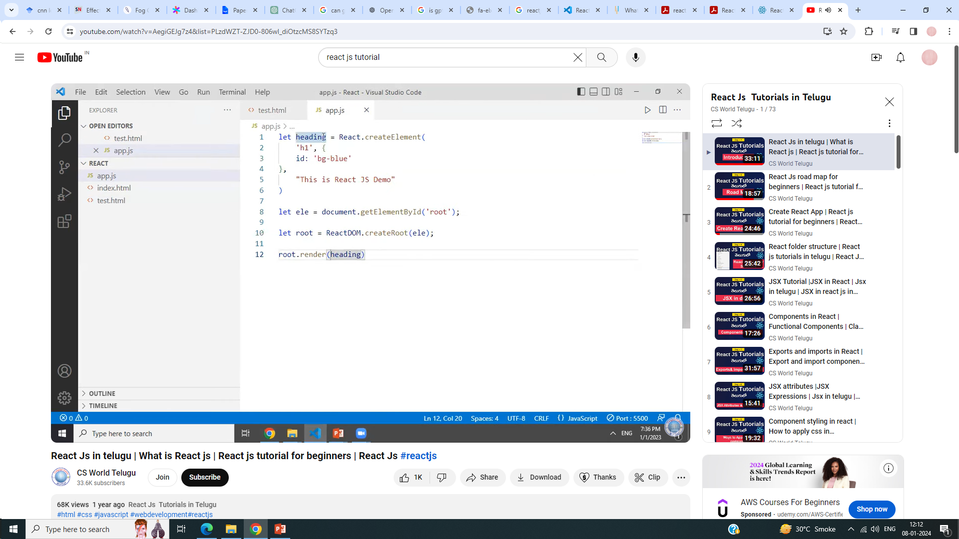

Slide 10
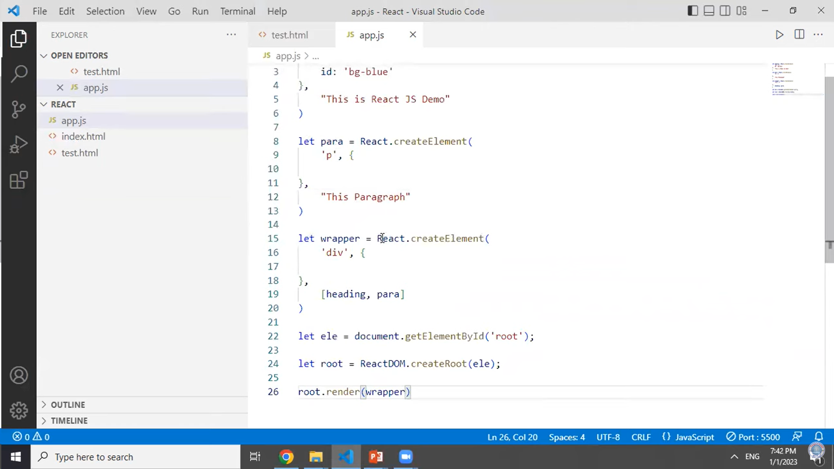

Slide 11
But adding elements to the UI in the above specified way is an inefficient process
So we have JSX in react JS.

Slide 12
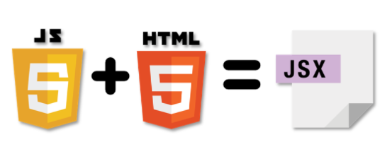
What is JSX?
JSX is a JavaScript syntactic extension. It's a term used in React to describe how the user interface should seem.
You can write HTML structures in the same file as JavaScript code by utilizing JSX.

Slide 13
JSX: the React programming language
const first = "Aaron"; const last = "Smith";
const name = <span>{first} {last}</span>;
const list = (
<ul>
<li>Dr. David Stotts</li>
<li>{name}</li>
</ul>
);
const listWithTitle = (
<>
<h1>COMP 523</h1>
<ul>
<li>Dr. David Stotts</li>
<li>{name}</li>
</ul>
</>
);

Slide 14
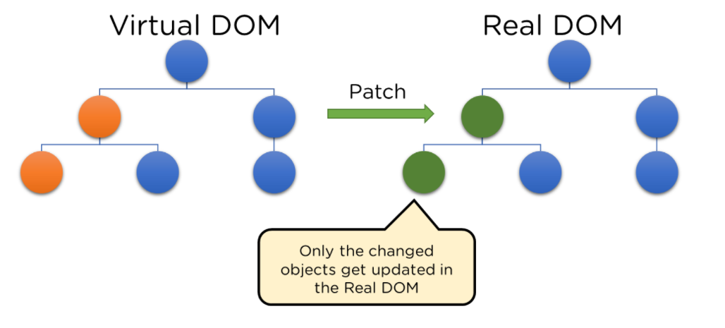
Virtual Document Object Model (DOM)
The Virtual DOM is React's lightweight version of the Real DOM. Real DOM manipulation is substantially slower than virtual DOM manipulation. When an object's state changes, Virtual DOM updates only that object in the real DOM rather than all of them.

Slide 15
When the state of an object changes in a React application, VDOM gets updated.
It then compares its previous state and then updates only those objects in the real DOM instead of updating all of the objects. (For this it uses a diffing algorithm and a process called reconciliation)
This makes things move fast, especially when compared to other front-end technologies that have to update each object even if only a single object changes in the web application.

Slide 16
Anatomy of a React component
The component is just a function
Inputs are passed through a single argument called “props”
The function outputs HTML
export default function MyComponent(props) {
return <div>Hello, world! My name is {props.name}</div>;
}
const html = <MyComponent name="aaron" />;
The function is executed as if it was an HTML tag
Parameters are passed in as HTML attributes

Slide 17
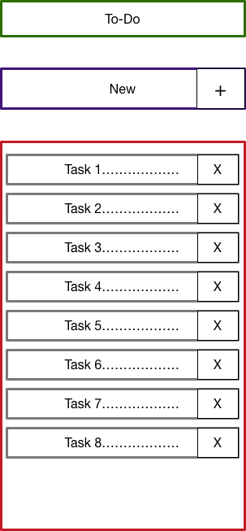
Todo application
Title
Big idea:
A digital to-do list
TodoForm
First step:
mockup / wireframe
TodoList
Todo

Slide 18
Component Hierarchy
Title
TodoForm
App
Title
TodoList
TodoForm
TodoList
Todo
Todo
Todo
Todo

Slide 19
Creating a new React app
Creating a new React app is simple!
Install Node.js
Run: npx create-react-app app-name
New app created in folder: ./app-name

Slide 20
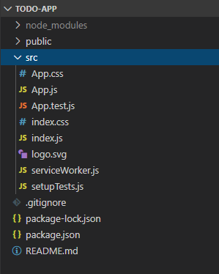
Anatomy of a new React app
public holds the initial html document and other static assets
App is a boilerplate starter component
index.js binds React to the DOM
package.json configures npm dependencies

Slide 21
Components and Props:
A component is a self-contained, reusable building block in React.
It encapsulates a piece of UI and its behavior.
Functional and class components
Functional Components:
A functional component is a JavaScript function that returns a React element.
It's simple and used for presentational purposes.

Slide 22
function Welcome(props) {
return <h1>Hello, {props.name}!</h1>;
}

Slide 23
Class Components:
A class component is a JavaScript class that extends React.Component.
It has additional features, such as state and lifecycle methods.
class Welcome extends React.Component {
render() {
return <h1>Hello, {this.props.name}!</h1>;
}
}

Slide 24
Rendering Components:
To render a component, use the component's name as a JSX tag.
const element = <Welcome name="John" />;

Slide 25
Props (short for properties) are a way to pass data from a parent component to a child component.
They are immutable and provide a mechanism for components to communicate.
Passing Props:
Pass props by adding attributes to the component JSX tag.

Slide 26
const element = <Welcome name="John" />;
// Functional Component
function Welcome(props) {
return <h1>Hello, {props.name}!</h1>;
}
// Class Component
class Welcome extends React.Component {
render() {
return <h1>Hello, {this.props.name}!</h1>;
}
}

